Slide 1
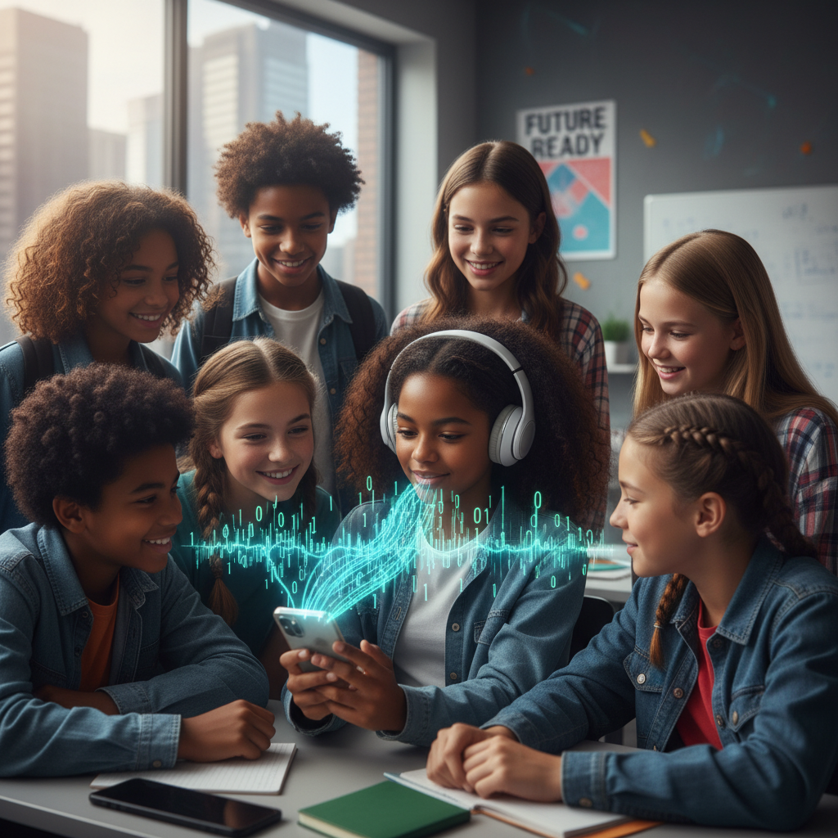
ModelIt!
Student Lesson
Your Phone Speaks in 1s and 0s
How Digital Signals Carry Music, Messages, and Memes
NGSS: MS-PS4-3
7th Grade
1/9

Slide 2
What You Will Learn Today
Learning Goals
* Compare how analog and digital signals encode information
* Explain how sampling rate affects digital signal quality
* Model how compression reduces file size while trading off accuracy
* Evaluate why digital signals are more reliable for transmitting information
Key Vocabulary
Analog Signal
A continuous signal that varies smoothly over time, like a sound wave or vinyl record groove
Digital Signal
Information encoded as discrete values — typically 1s and 0s (binary) — that can be exactly copied
Sampling Rate
How many times per second an analog signal is measured to create a digital version (measured in Hz)
Compression
Reducing file size by removing some data — lossy compression removes data permanently, lossless preserves everything
2/9

Slide 3

The Big Question
Why does your music sound perfect every time you play it — but your grandparents' vinyl records got scratchy?
How Digital Signals Carry Music, Messages, and Memes. Today we'll build a MODEL to discover the answer!
3/9

Slide 4

Today We Will Build a Model!
A model helps us understand complex systems!
1. LOCATE
Identify the COMPONENTS (parts) of the system
2. ESTABLISH
Connect them with RELATIONSHIPS (+ or -)
3. VISUALIZE
Build your model in ModelIt!
4. EVALUATE
Run SIMULATIONS to test scenarios
5. REVISE
Improve your model based on evidence
4/9

Slide 5

Activity 1: Sort the Components
Sort these components into EXTERNAL (inputs from outside) and INTERNAL (inside the system):
Your Components:
* Sampling Rate
* Compression Level
* Signal Accuracy
* File Size
Think: Which components can we control? Which happen on their own?
5/9

Slide 6
Activity 2: Connect with Arrows
Draw arrows to show HOW components affect each other:
(+) POSITIVE Relationship
When one goes UP, the other goes UP too
(-) NEGATIVE Relationship
When one goes UP, the other goes DOWN
Think About It:
When you download a song, you're choosing between file size and sound quality. What happens to the music when compression is pushed too far?
6/9

Slide 7
Activity 3: Run the Simulation!
Test these scenarios in ModelIt!
Studio Quality
Set Sampling Rate to maximum and Compression Level to minimum. Observe Signal Accuracy and File Size.
Phone Streaming
Set Sampling Rate to medium and Compression Level to medium. Compare accuracy and file size to Studio Quality.
Extreme Compression
Set Compression Level to maximum while keeping Sampling Rate at medium. What happens to Signal Accuracy?
Watch the activity graphs change!
[ModelIt Platform Screenshot - Simulation Results Graph]
7/9

Slide 8
What Did We Discover?
Our Model Showed Us:
* Higher sampling rates produce more accurate digital copies but create larger files
* Moderate compression reduces file size significantly with barely noticeable quality loss
* Extreme compression destroys enough data that quality drops dramatically — you can hear the difference
* Digital signals can be copied perfectly (unlike analog), making them ideal for storage and transmission
Answer: Digital signals encode information as exact numbers (1s and 0s) that can be copied perfectly every time. Your grandparents' vinyl records were analog — each play physically wore the grooves, adding scratches and noise. A digital music file sounds identical on its millionth play because the 1s and 0s never change. The trade-off is that converting analog to digital requires choosing a sampling rate (detail level) and compression level (file size), which affects how closely the digital version matches the original.
8/9

Slide 9

STEM Challenge: The Streaming Service Challenge
YOUR ENGINEERING MISSION
Design a music streaming service that delivers the best possible sound quality while keeping data usage low enough for mobile users.
The Challenge:
Your startup is launching a music streaming app. Users on Wi-Fi want studio quality, but mobile users have limited data plans. You need to design a system that automatically adjusts quality based on connection type — without making the music sound terrible.
Think Like an Engineer:
* What sampling rate and compression settings should you use for Wi-Fi vs. mobile data?
* How do you decide the minimum acceptable quality before users notice degradation?
* What other factors besides sound quality matter to your streaming service users?
REAL CAREER CONNECTION: Audio Engineers use signal processing to record, mix, and master music. They understand sampling rates, compression, and digital audio workstations (DAWs). They work in recording studios, live concerts, film production, and video game audio — combining physics, math, and creativity. The skills you're using TODAY are the same ones they use on the job!
9/9

